Slide 1
LEO-E&T Serving Michigan Businesses
October 6, 2023

Slide 2
Who is Employment & Training?
Bureau of Services for Blind Persons (BSBP) believes in the capacity of people who are blind or visually impaired to achieve employment and independence, providing training and other services that empower people to achieve their individual goals.
Michigan Rehabilitation Services (MRS) provides specialized employment and education-related services and training to assist teens and adults with disabilities in becoming employed, advancing in, or retaining employment.
Workforce Development (WD) supports a demand driven workforce system, assists the structurally unemployed with financial independence, advocates for the integration of workforce development into the K-12 school system, and supports the alignment of workforce development with economic development efforts.
Michigan.gov/LEO/Employment-and-Training

Slide 3
LEO Operational Plan
1. Support more than 218,000 participants in LEO-E&T programs.
2. Upskill Michiganders and leverage resources that lead to 7,500
postsecondary credentials.
3. Assist 3,800 adult learners in earning a High School diploma or equivalent.
4. Employ 67,500 Michiganders resulting from LEO-E&T programs.
5. Increase the quarterly median wages earned by participants in
LEO-E&T programs to $6,240 ($24,960 annually).

Slide 4
Teams Serving Michigan Businesses
Staff from BSBP, MRS & WD
Supporting immediate & long-term workforce solutions
Michigan.gov/BackToWork
Business Solutions Professionals at all 16 MWAs
Addressing local challenges & opportunities
MichiganWorks.org

Slide 5
Virtual Job Fairs
Save time & money
Less money on in-person event items
Less time out of office
Less money on travel costs
See job seekers at-a-glance
Attract a wider & more diverse audience
Access available job seekers, including UIA claimants & Pure Michigan Talent Connect users
LEO-VJF@michigan.gov

Slide 6
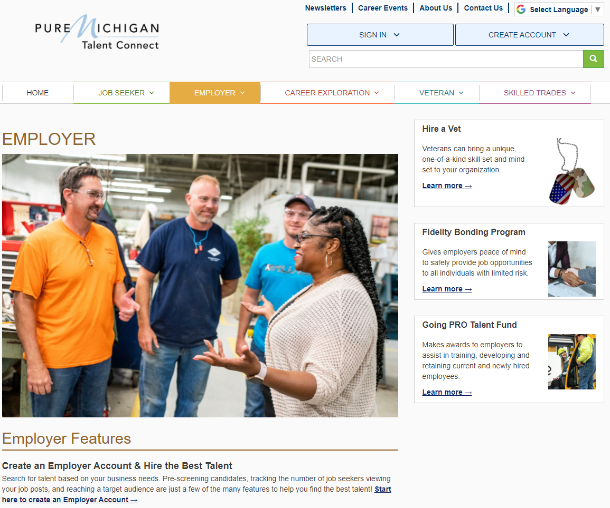
Post jobs
Search for talent
Access employer resources
MiTalent.org

Slide 7
New job seeker accounts on the state’s labor exchange are asked to indicate interest in career opportunities – including EV Jobs Academy.
Since the function went live in May 2023, outcomes have included:
10,976 PMTC job seekers have identified interest in EV Jobs Academy (18% of all job seekers)
Email follow-ups with additional information have:
60% open rate
Sent 376 readers to EV Jobs Academy website for additional action
MiTalent.org

Slide 8
Sector Strategies Employer-Led Collaboratives
Michigan Department of Labor and Economic Opportunity, Workforce Development (LEO-WD) supports high-demand industries and development of Employer-Led Collaboratives (ELCs) throughout Michigan.
ELCs bring together partners to formulate solutions to fill identified talent gaps.
Employers
Education and training institutions
Workforce development organizations
Other applicable partners, such as economic development organizations, labor unions and government
Michigan.gov/SectorStrategies

Slide 9
Sector Strategies Employer-Led Collaboratives
ELCs identified as a national best practice.
Call-to-action for private / public partners to work collaboratively determining how to strategically develop, train and retain a skilled workforce meeting the talent needs of key industries in Michigan.
Neutral organization acting as a facilitator to mobilize employers and partners.
Demand Planning – identification of projected high-demand occupations and job openings
Identification of competencies, credentials and other hiring requirements
Talent Flow Analysis to identify talent sources
Implementation of ELC-identified solutions
Evaluation and continuous improvement of ELC metrics and sustainability plans
Michigan.gov/SectorStrategies

Slide 10
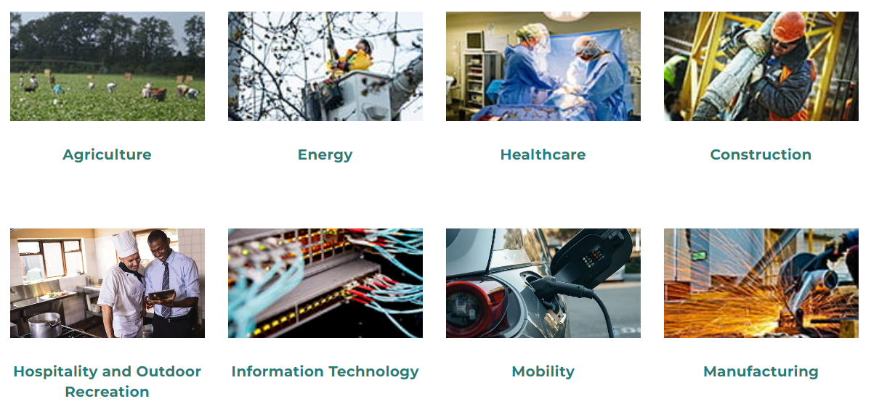
Sector Strategies Employer-Led Collaboratives
Supporting the needs of industries & regions
Michigan.gov/SectorStrategies

Slide 11
Electric Vehicle Jobs Academy (EV Jobs Academy)
EV Jobs Academy is an employer-driven initiative to align industry talent needs with training and recruitment to connect talent to good-paying jobs in the EV industry.
Comprehensive end-to-end model for building talent pipelines
Employer-led collaborative model
Employers can join at any time
Expanded leadership role for employers
Comprised of 100+ stakeholder partners
Committed to growing the talent pipeline for existing and emerging occupations
Michigan.gov/EVJobsAcademy
Notes:
Statewide initiative comprised of over 100 stakeholder partners
Employer-led Collaborative committed to growing the talent pipeline for existing and emerging occupations
Based on supply-chain principles of supply & demand for talent
The partners include 12 MWAs that have active EV Jobs Academy employers in their region
Open to additional Mobility/EV employers to join
Continuously evaluate the ROI for employers throughout the process
Committed to process improvement

Slide 12
Employers
Educator Partners
Outreach, Recruitment & Training
Employment
Commit to participation
Vet LMI Data
Align hiring and skills needs
Identified by employers as preferred providers of training
Co-design curriculum based on employer validated needs
Share program information with students and partners
Recruit job seekers into approved programs
Incumbent workers trained
Job seekers connected to EV Jobs Academy employers
Training completed by job seekers
Resiliency Planning & Continuous Improvement
Continuous Improvement
Michigan.gov/EVJobsAcademy
Notes:
Expanded employer leaderships – looking at ROI for employers
Strong partnerships with education partners to align curriculum and student recruitment
Other outreach partners include CBOs, MWAs, education partners, and employer partners
In addition to be employer-driven, the work of EV Jobs Academy is data-driven – the data and research partners is led by the Center for Automotive Research

Slide 13
Goals
Prepare individuals for emerging technologies
Target training to incumbent, displaced and historically underserved populations seeking opportunities in the mobility and automotive sectors
Minimally 35% of program participants will come from underrepresented populations including youth, veterans, women, people of color, ex-offenders and persons with disabilities
Increase employer participation by 50% with two-thirds of the state covered with mobility and electrification industry ELCs
Michigan.gov/EVJobsAcademy

Slide 14
Strategies
Identifying competencies, credentials and other hiring requirements
Demand planning; identifying projected job openings
Reskilling and upskilling incumbent workers
Training opportunities for job seekers interested in automotive mobility and electrification industry
Developing career pathways that provide advancement opportunities within and outside of ELC companies
Career awareness, exploration and promotion of automotive and electrification industry occupations
Michigan.gov/EVJobsAcademy

Slide 15
Going PRO Talent Fund
Awards to employers to assist in training, developing and retaining current and newly hired employees
Flexible & responsive training that results in a credential, certificate or degree
Talent Fund Outcomes (2014-2023)
Michigan.gov/TalentFund

Slide 16
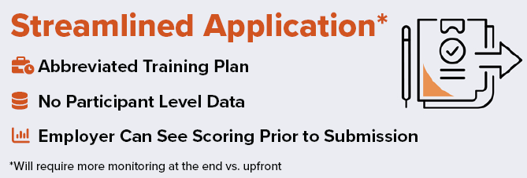
Going PRO Talent Fund
FY23 Program Enhancements
Michigan.gov/TalentFund

Slide 17
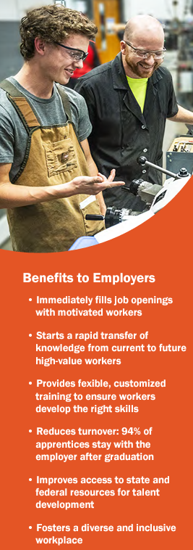
Registered Apprenticeship
Registered Apprenticeship – benefits job seekers & businesses
Expanding & supporting youth apprenticeship
Registered Apprenticeship supports Sixty by 30
Reimbursement funding can be braided with Going Pro Talent Funds
Streamlined process to launching a program
Michigan Apprenticeship Advisory Board
Contact a Michigan Works! Apprenticeship Success Coordinator to get started
Michigan.gov/Apprenticeship

Slide 18
Adult Education
Assists adults in becoming literate and obtaining knowledge and skills for post-secondary education, employment and economic self-sufficiency
Assists immigrants and English language learners in improving English proficiency
Supports employers by providing workplace literacy and remediation services on-site to upskill current workers
Michigan.gov/LearnMoreEarnMore

Slide 19
Vocational Rehabilitation
Reasonable Accommodation Consultation
Assistive Technology
Universal Design & Ergonomic Consultation
Disability Awareness Training
Supportive Services for Targeted Populations
Michigan.gov/BackToWork

Slide 20
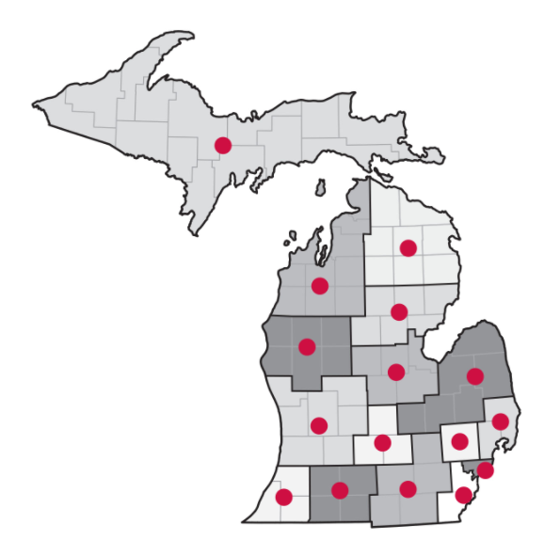
Michigan Works! Agencies (MWAs)
Statewide network of 16 regional organizations
Business Solutions Professionals available to support you
Visit MichiganWorks.org
Call your One-Stop Service Center at 800-285-WORKS (9675)
MichiganWorks.org

Slide 21
Lisa Larson
Industry Engagement Specialist
Address
P.O. Box 30805
Lansing, MI 48909
Email
larsonl6@michigan.gov
Phone
517-465-0905
Website
Michigan.gov/LEO

